Slide 1

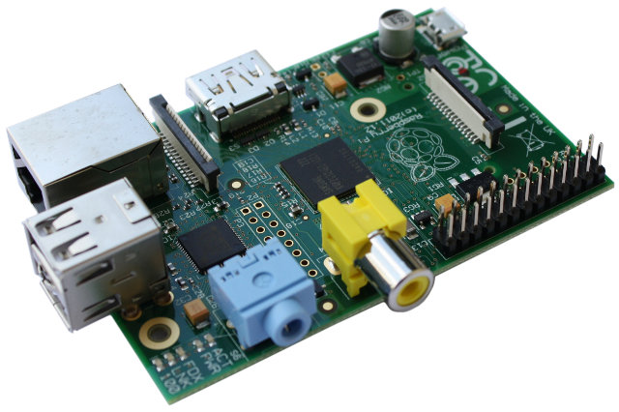
The Raspberry Pi Initiative
The Raspberry Pi Initiative
@stevenpfloyd
@katrina_massey1
A Context For Authentic and Collaborative Discovery

Slide 2
The Raspberry Pi Initiative
@stevenpfloyd
@katrina_massey1
Become Familiar With The RPi
Complete Some Specific Tutorials
Scratch, Python, Breadboard and LEDs, Rpi Camera
Some Other RPi Tools
See Pedagogical Practices and Assignments

Slide 3
The Raspberry Pi Initiative
@stevenpfloyd
@katrina_massey1
Exploratory
Collaborative
Differentiated
Relaxed
Patient
Inquisitive
Scattered?
Learn stuff

Slide 4
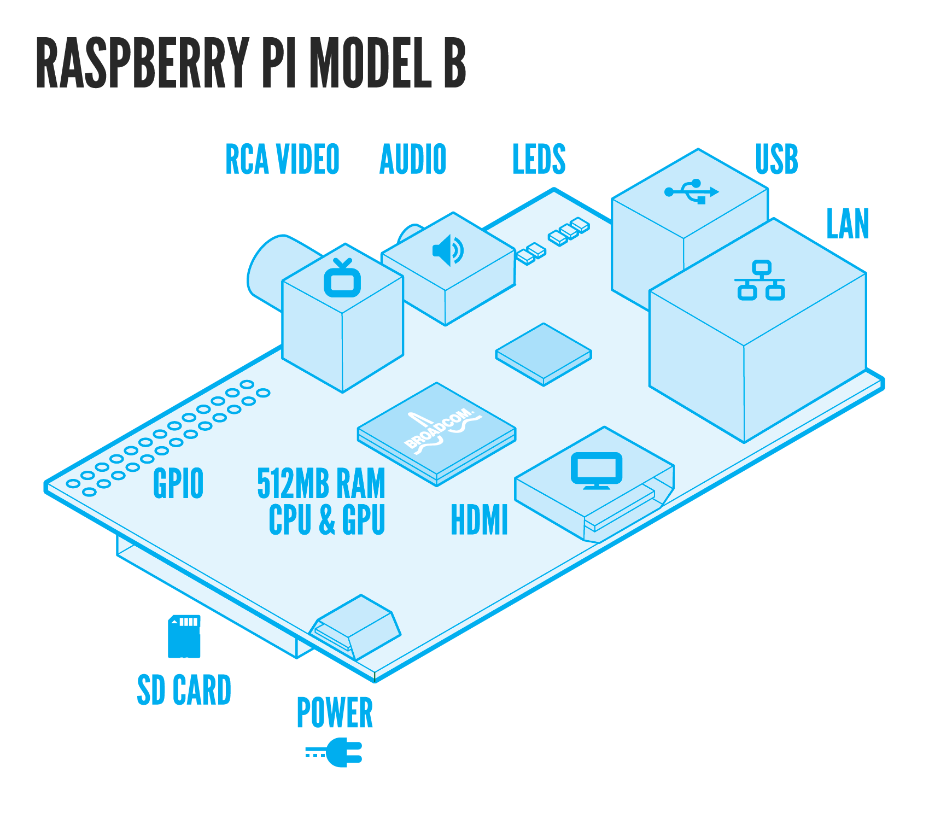
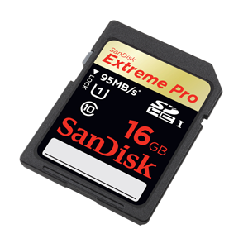
The Raspberry Pi Initiative
@stevenpfloyd
@katrina_massey1
A computer without a hard drive
A separate SD card stores O/S, software, files

Slide 5
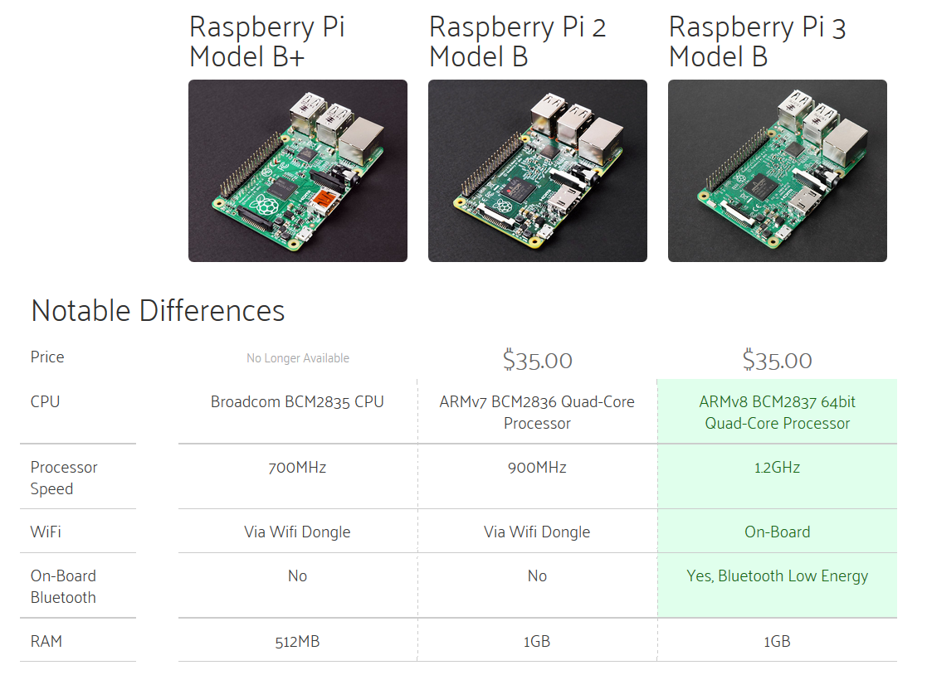
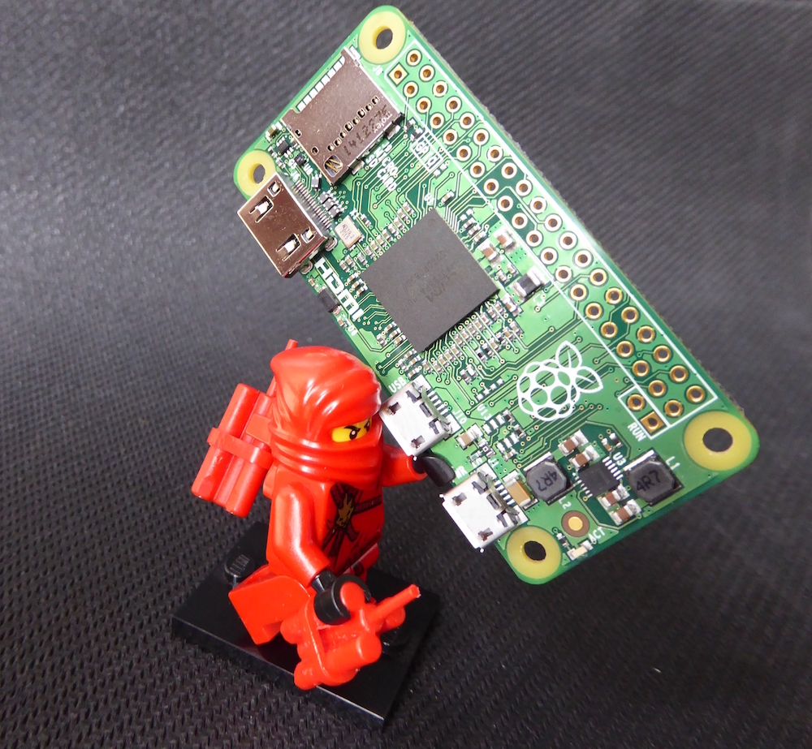
The Raspberry Pi Initiative
@stevenpfloyd
@katrina_massey1
First released in 2012 - UK
Numerous versions and updates

Slide 6
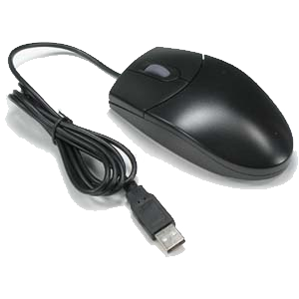
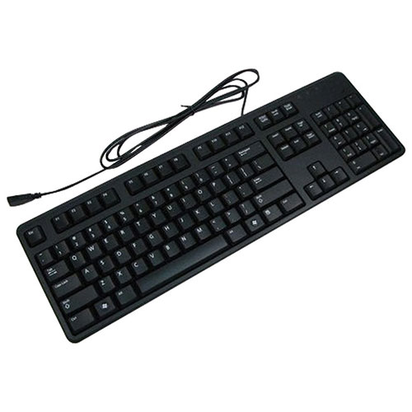
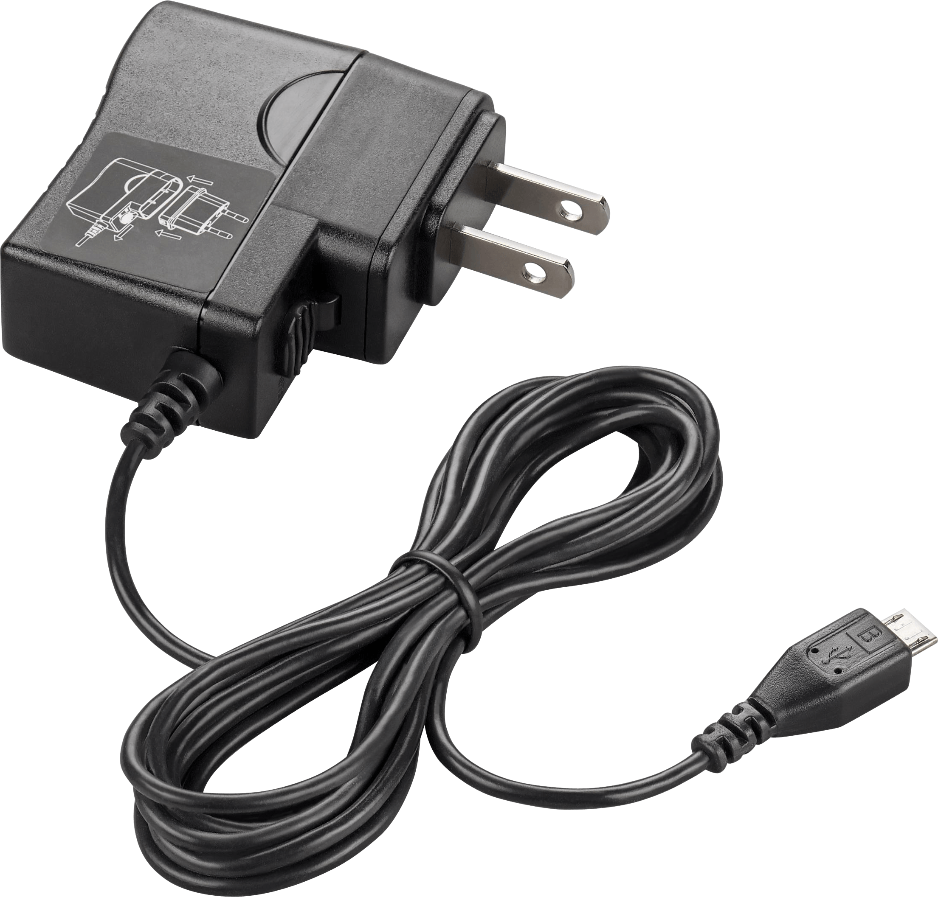
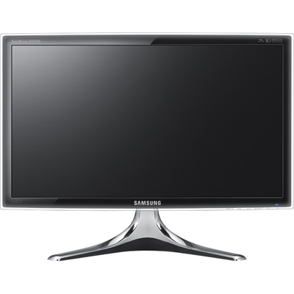
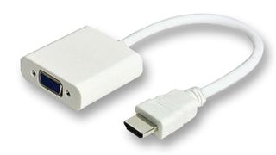
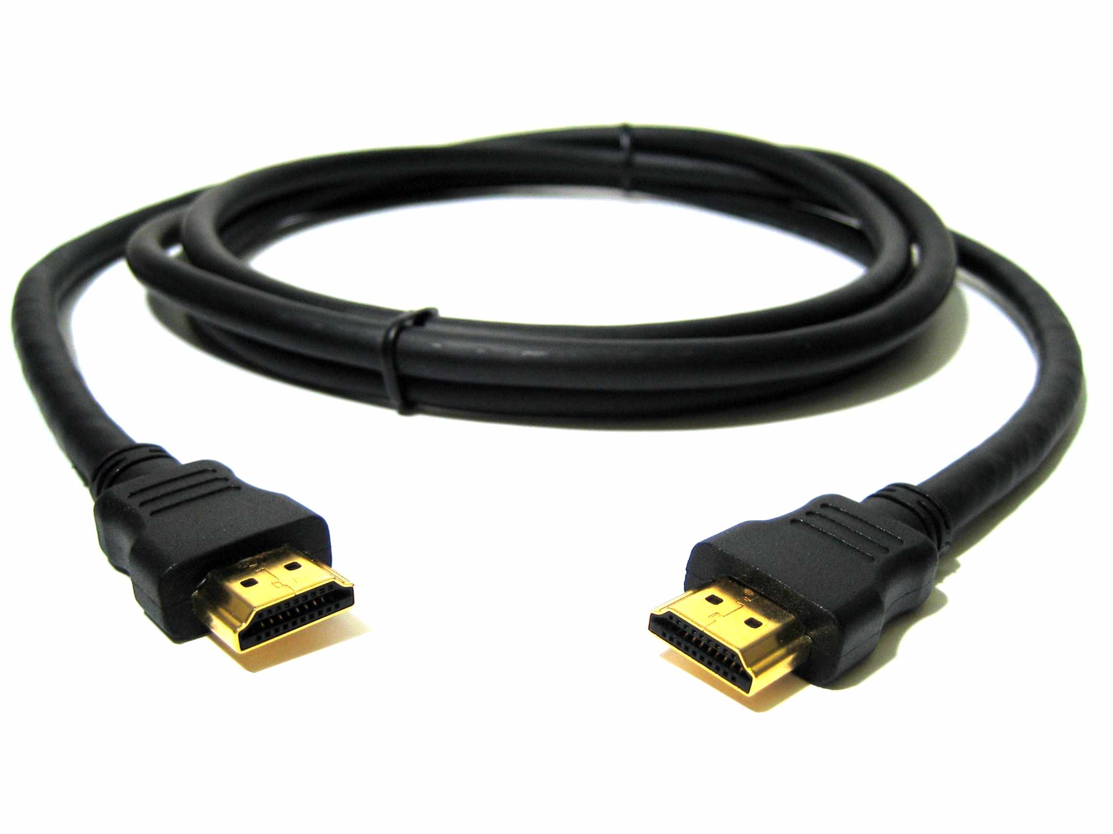
The Raspberry Pi Initiative
@stevenpfloyd
@katrina_massey1
Let’s get started…
Plug it all in… POWER LAST!!!

Slide 7
The Raspberry Pi Initiative
@stevenpfloyd
@katrina_massey1
$10.00
$8.00
$15.00
$20.00
$40.00
$20.00

Slide 8




Where…
The Raspberry Pi Initiative
@stevenpfloyd
@katrina_massey1

Slide 9
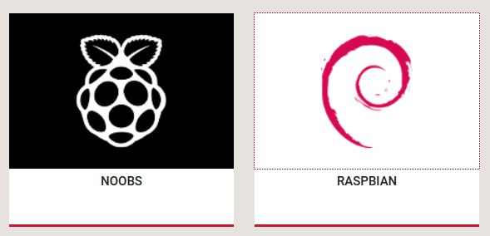
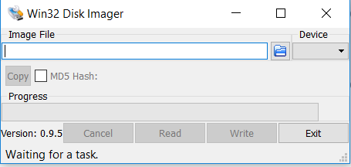
The Operating System…
The Raspberry Pi Initiative
@stevenpfloyd
@katrina_massey1
Noobs can be downloaded, unzipped, files then copied to SD
Raspbian can be downloaded, unzipped, image then written to SD
We are using Raspbian, written to SD using Win32DiskImager

Slide 10

The Raspberry Pi Initiative
@stevenpfloyd
@katrina_massey1
Free and open source package of business software
Can be compared to MSOffice

Slide 11
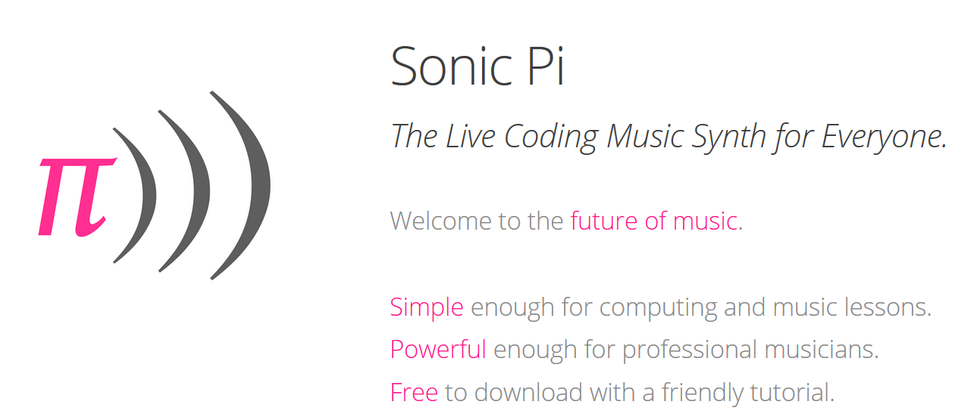
The Raspberry Pi Initiative
@stevenpfloyd
@katrina_massey1

Slide 12
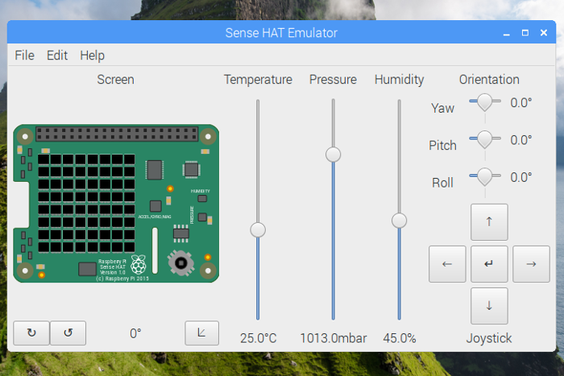
The Raspberry Pi Initiative
@stevenpfloyd
@katrina_massey1

Slide 13
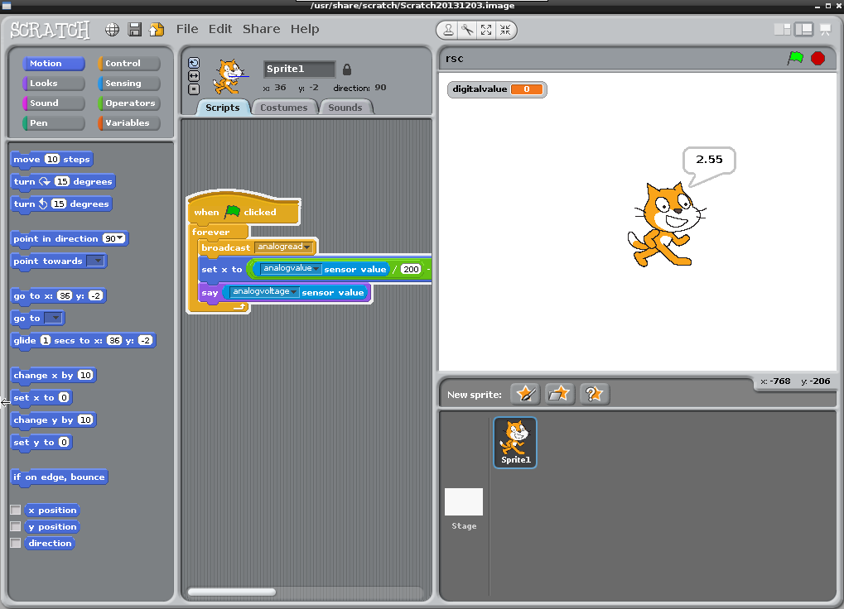
The Raspberry Pi Initiative
@stevenpfloyd
@katrina_massey1

Slide 14
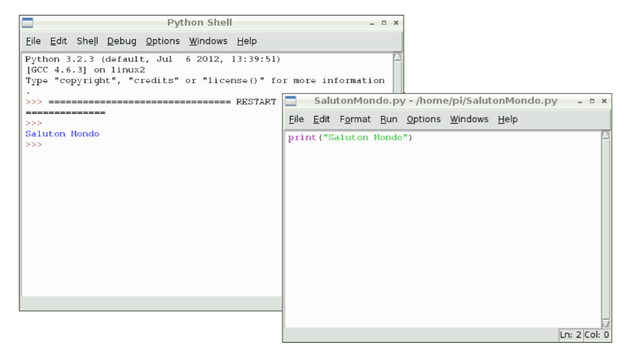
The Raspberry Pi Initiative
@stevenpfloyd
@katrina_massey1

Slide 15

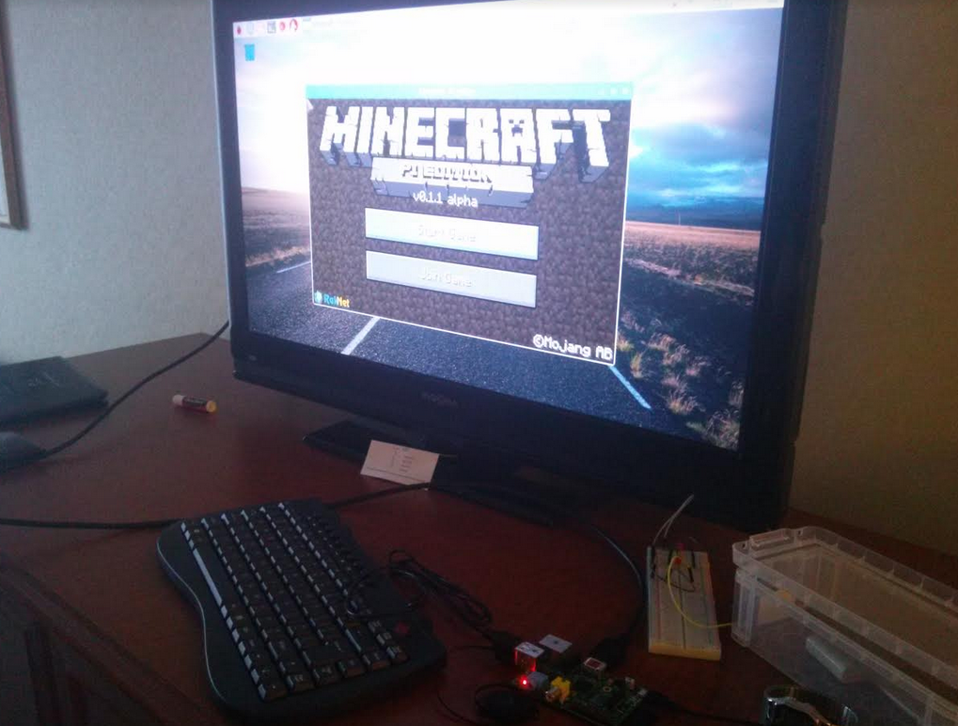
The Raspberry Pi Initiative
@stevenpfloyd
@katrina_massey1

Slide 16
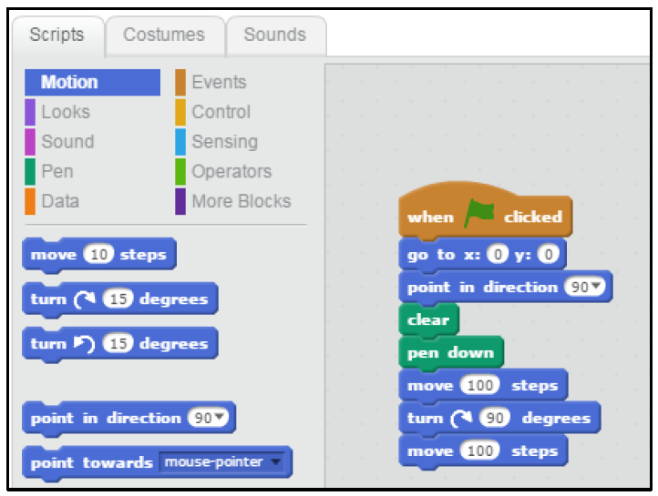
The Raspberry Pi Initiative
@stevenpfloyd
@katrina_massey1
Let’s Try Some Scratch Programming…

Slide 17
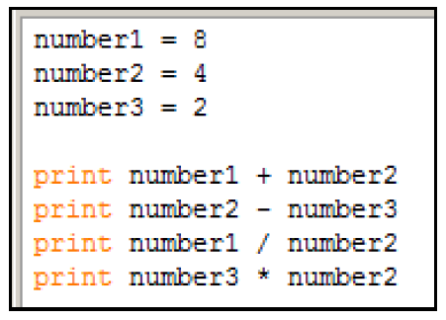
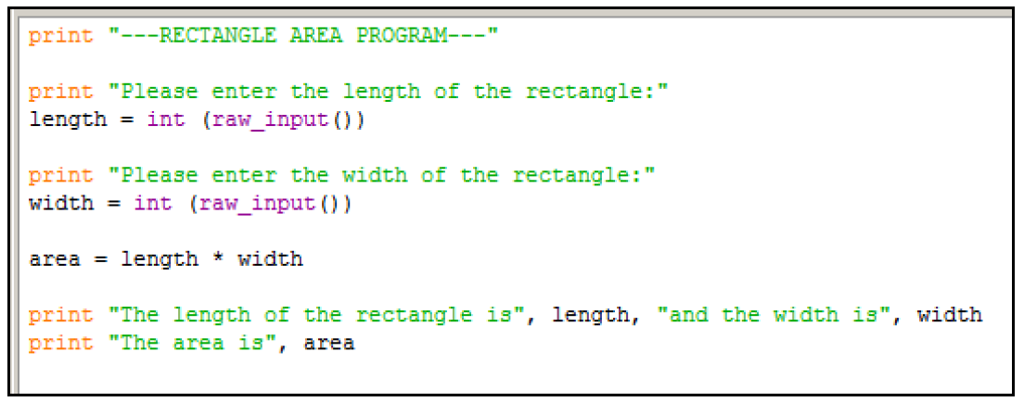
The Raspberry Pi Initiative
@stevenpfloyd
@katrina_massey1
Python Programming, some basic code and the IDLE…

Slide 18
The Raspberry Pi Initiative
@stevenpfloyd
@katrina_massey1
Let’s Try Some Python Programming…

Slide 19
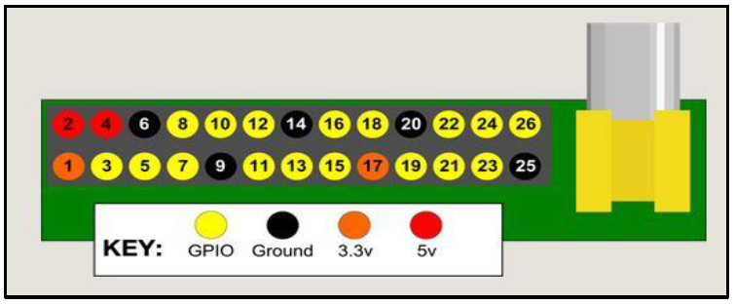
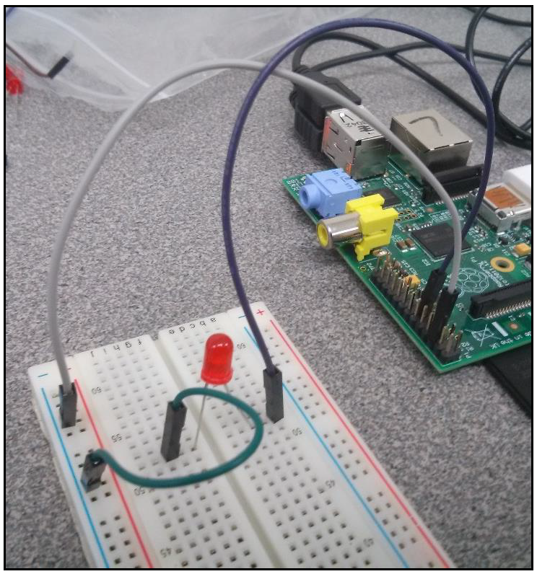
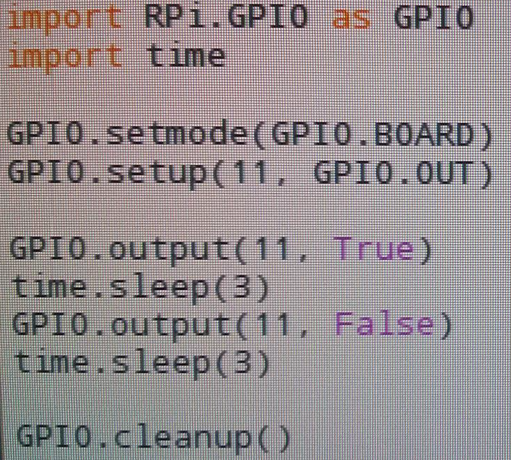
The Raspberry Pi Initiative
@stevenpfloyd
@katrina_massey1
General Purpose Input/Output Pins
And Breadboarding….

Slide 20
The Raspberry Pi Initiative
@stevenpfloyd
@katrina_massey1
Let’s try out some GPIO pins…

Slide 21
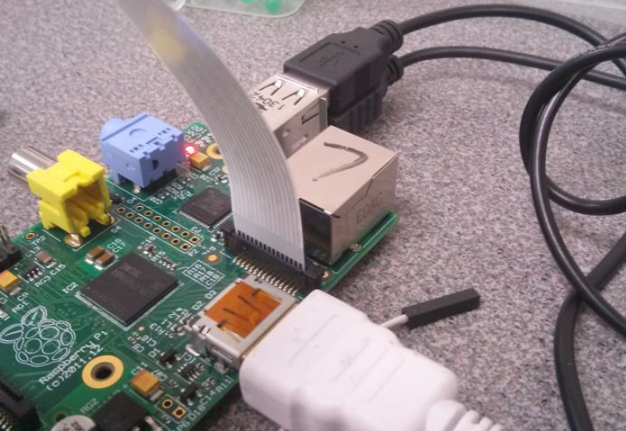
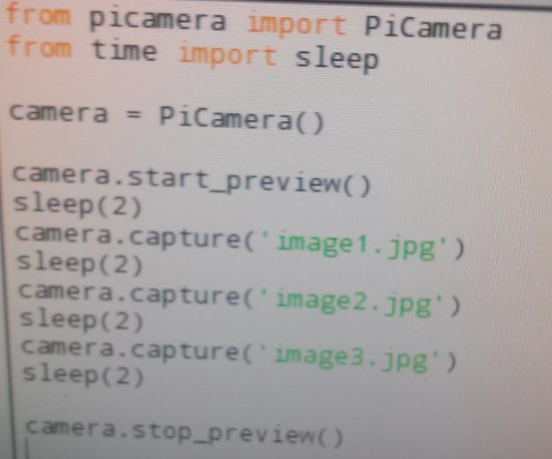
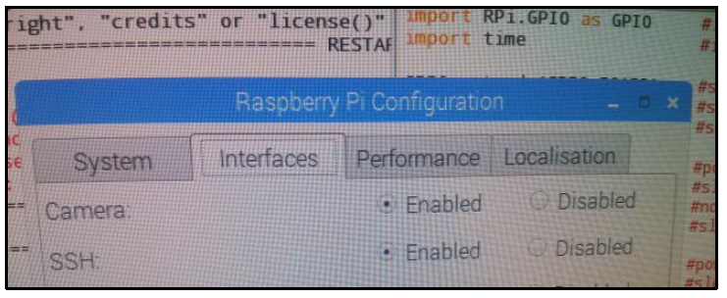
The Raspberry Pi Initiative
@stevenpfloyd
@katrina_massey1
RPi Camera

Slide 22
The Raspberry Pi Initiative
@stevenpfloyd
@katrina_massey1
Let’s try out the RPi Camera…

Slide 23
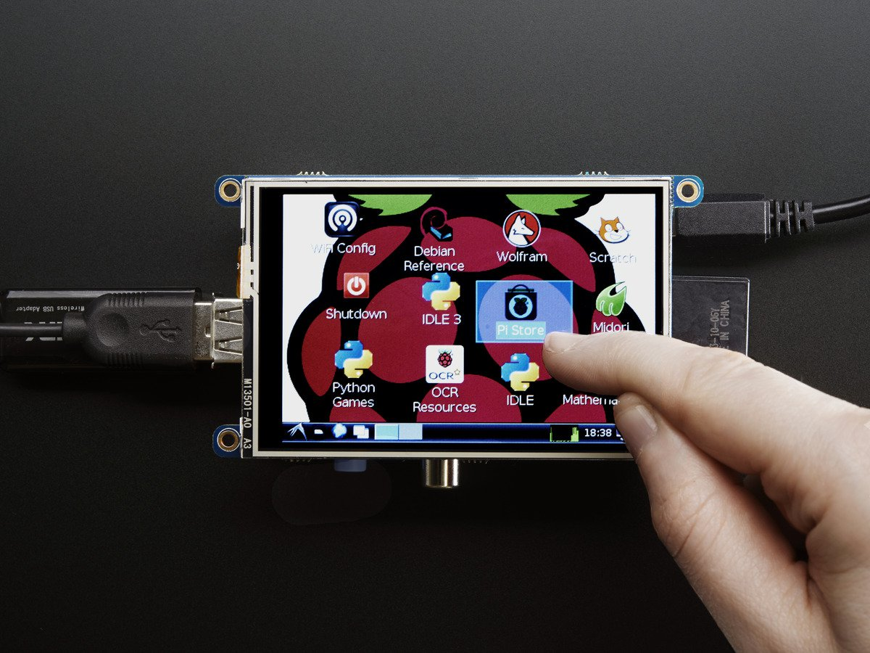
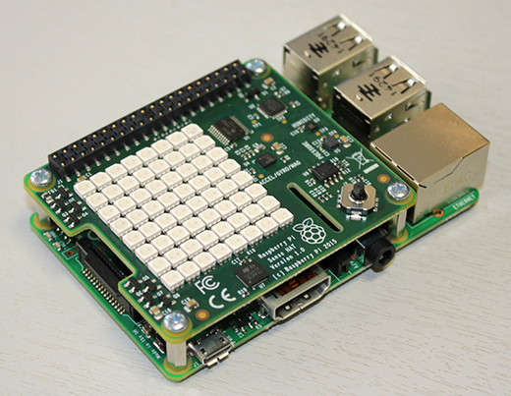
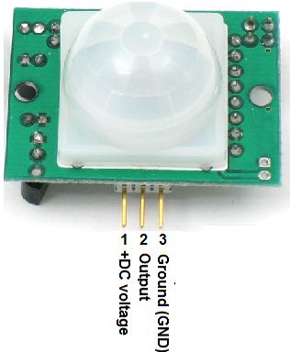
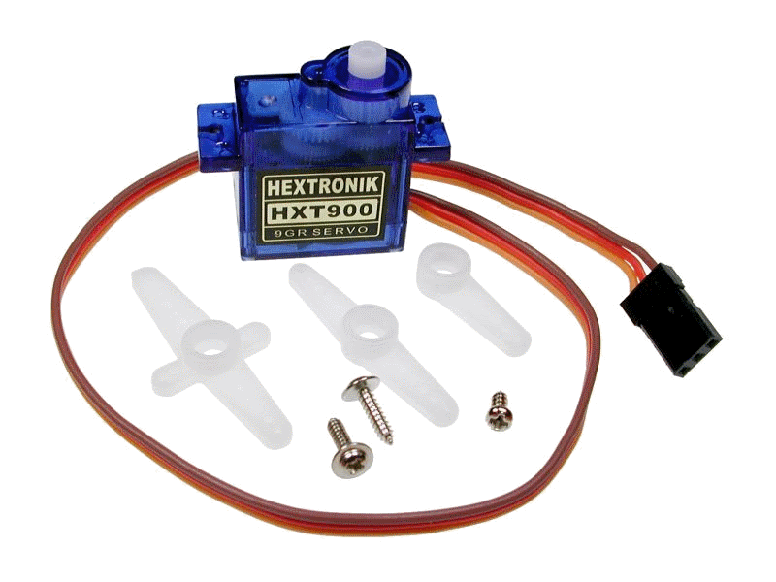
The Raspberry Pi Initiative
@stevenpfloyd
@katrina_massey1

Slide 24
The Raspberry Pi Initiative
@stevenpfloyd
@katrina_massey1
Student projects…
YouTube: The RPi Initiative

Slide 25
The Raspberry Pi Initiative
The Raspberry Pi Initiative
@stevenpfloyd
@katrina_massey1
A Context For Authentic and Collaborative Discovery

Slide 26
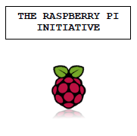

Slide 27
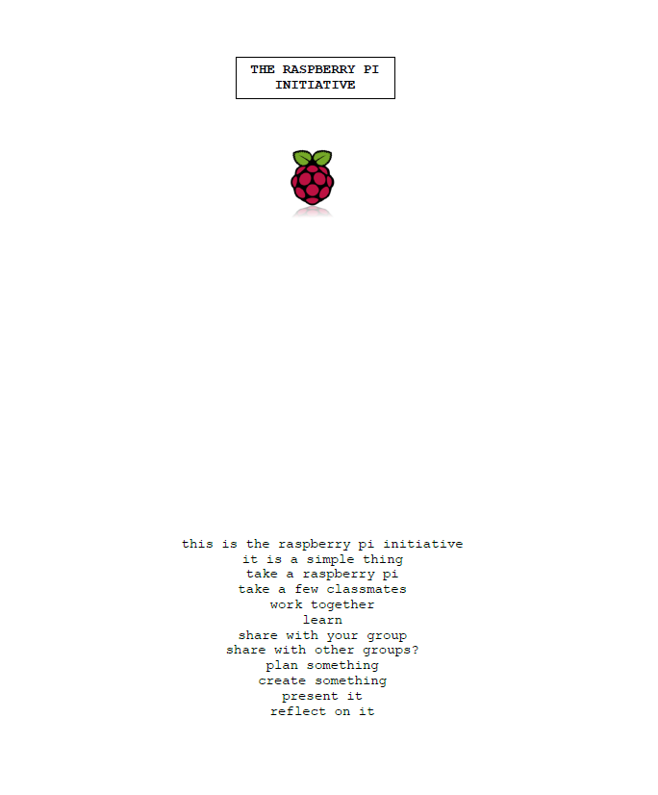

Slide 28
